Slide 1
Behavioural & Experimental Economics Probability Judgement
Lunzheng Li
University of Cyprus

Slide 2
Course Outline
Choice under Certainty
Judgement under Risk & Uncertainty
Choices under Risk & Uncertainty
Intertemporal Choice
Strategic Interaction

Slide 3
Course Outline
Choice under Certainty
Judgement under Risk & Uncertainty
Probability Judgement
Judgement under Risk & Uncertainty
Choices under Risk & Uncertainty
Intertemporal Choice
Strategic Interaction

Slide 4
How to model uncertainty
We will use Probability Theory
It is widely accepted as the correct normative theory of probabilistic judgement

Slide 5
Example 1
You are visiting your new neighbour, Mrs Jones. She tells you that she has two children playing in their room.
Assume that each time somebody has a child, the probability of having a girl is the same as the probability of having a boy (and whether the mother had a boy or a girl the first time around does not affect the probabilities involved the second time around).
Now, Mrs Jones tells you that at least one of the children is a girl. What is the probability that the other child is a girl, too?

Slide 6
Example 2
Linda is 31 years old, single, outspoken and very bright.
She majored in philosophy. As a student, she was deeply concerned with discrimination and social justice issues and participated in anti-nuclear demonstrations.
Which of the following statements is more likely to be true?
Linda is a bank teller
Linda is a bank teller and a feminist

Slide 7
Important Definitions
An outcome space is the set of all possible individual outcomes: {A,B,C,…}
An outcome is a subset of the outcome space.
A probability function Pr(∙) assigns a real number in [0,1] to each outcome in the outcome space.
The number Pr(A) is the probability of A.

Slide 8
Important Definitions, cont.
Outcomes are equiprobable if they occur with the same probability.
Outcomes are mutually exclusive if no more than one of them can occur at any one time.
Outcomes are independent if the occurrence of the one does not affect the probability of the other one occurring.

Slide 9
Rules of Probability
The EQUIPROBABILITY Rule: If individual outcomes {A₁,A₂,…,A_{n}} are equiprobable, then the probability of any one individual outcome A_{i} is 1/n, that is: Pr(A_{i})=1/n.
The OR Rule: If outcomes A and B are mutually exclusive, then the probability of A or B equals the probability of A plus the probability of B, that is: Pr(AvB)=Pr(A)+Pr(B)

Slide 10
Example
A roulette wheel has spaces numbered from 1–36 alternating red and black plus two additional spaces, 0 and 00, both colored green. Thus, there are 18 red spaces, 18 black spaces, and 2 green spaces. What is:
The probability of getting black?
The probability of getting black or green?
The probability of spinning an odd number, 0, or 00?

Slide 11
Example 1
You are visiting your new neighbour, Mrs Jones. She tells you that she has two children playing in their room.
Assume that each time somebody has a child, the probability of having a girl is the same as the probability of having a boy (and whether the mother had a boy or a girl the first time around does not affect the probabilities involved the second time around).
Now, Mrs Jones tells you that at least one of the children is a girl. What is the probability that the other child is a girl, too?

Slide 12
Rules of Probability, cont.
The Everything Rule: The probability of the entire outcome space equals 1.
The Not Rule: The probability that some outcome A will not occur equals 1 minus the probability that it does, that is: Pr(¬A)=1–Pr(A).
The And Rule: If outcomes A and B are independent, the probability of A and B equals the probability of A times the probability of B, that is: Pr(A and B)=Pr(A)*Pr(B).

Slide 13
More Examples
A roulette wheel has spaces numbered from 1–36 alternating red and black plus two additional spaces, 0 and 00, both colored green. Thus, there are 18 red spaces, 18 black spaces, and 2 green spaces.
Consider the roulette wheel again. What is:
The probability of not getting a number between 1 and 10?
The probability of getting red, black, or green?
The probability of getting black on the first spin and green on the second spin?

Slide 14
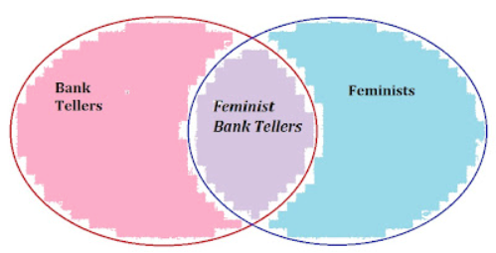
Example 2
Linda is 31 years old, single, outspoken and very bright.
She majored in philosophy. As a student, she was deeply concerned with discrimination and social justice issues and participated in anti-nuclear demonstrations.
Which of the following statements is more likely to be true?
Linda is a bank teller
Linda is a bank teller and a feminist
Conjunction Fallacy

Slide 15
Conditional Probability
The probability that something happens given that something else has happened is called conditional probability.
If A and B are two outcomes, the probability of A conditional of B equals the probability of A and B divided by the probability of B, that is:
Pr(A│B)=Pr(A and B)/Pr(B).

Slide 16
More Rules of Probability
The General And Rule: The probability of A and B equals the probability of A conditional on B times the probability of B, that is: Pr(A and B)=Pr(A│B)*Pr(B).
NB: A and B need not be independent.
The following are logically equivalent:
Pr(A│B)=Pr(A)
Pr(B│A)=Pr(B)
Pr(A and B)=Pr(A)*Pr(B)

Slide 17
Even More Examples
A roulette wheel has spaces numbered from 1–36 alternating red and black plus two additional spaces, 0 and 00, both colored green. Thus, there are 18 red spaces, 18 black spaces, and 2 green spaces.
Consider the roulette wheel again.
What is the probability of getting a 00 given that you spun a green?
What is the probability that you spun a 17 given that you got an even number?

Slide 18

Another Example
Suppose that you are running a frisbee factory and that you want to know the probability that one of your products is defective.
There are two machines:
a new one (B) producing 800 frisbees per day, with 1% being defective (D).
an old one (¬B) producing 200 per day, with 2% being defective.
What is the probability that a randomly selected frisbee produced in your factory is defective?

Slide 19
Pr(D|B)
D
B
Pr(B)
Pr(¬D|B)
¬D
Pr(D| ¬B)
D
Pr(¬B)
¬B
Pr(¬D| ¬B)
¬D

Slide 20
Total Probability and Bayes’s Rule
The Rule of Total Probability:
Pr(D)=Pr(D|B)*Pr(B)+Pr(D|¬B)*Pr(¬B)
Bayes’s Rule:
Pr(B|D)=Pr(D|B)*Pr(B)/Pr(D)
By applying the Rule of Total Probability to the denominator, we get:
Pr(D|B)*Pr(B)
Pr(D|B)*Pr(B) + Pr(D|¬B)*Pr(¬B)
Pr(B|D) =

Slide 21
Examples
Ten percent of a company’s employees are smokers. For each nonsmoker, the chance of taking a sick day in the next year is 0.01. For each smoker, the chance of taking a sick day is 0.05. Given that a worker is sick, what is the chance he was a smoker?

Slide 22
Bayesian Updating
Bayesian updating is the process of updating beliefs in accordance with Bayes’s Rule.
Let H stand for the hypothesis and E for the evidence
Pr(H), is called the prior probability
Pr(H|E), is called the posterior probability

Slide 23
Example
Wes and John are trying to determine whether or not a coin has two heads. They cannot see the coin and only know the outcome after it is flipped.
Wes believes with 50% confidence that it has two heads. John thinks it is unlikely and assigns a probability of only 1% to that.
The first flip is heads. What is his updated probability?

Slide 24
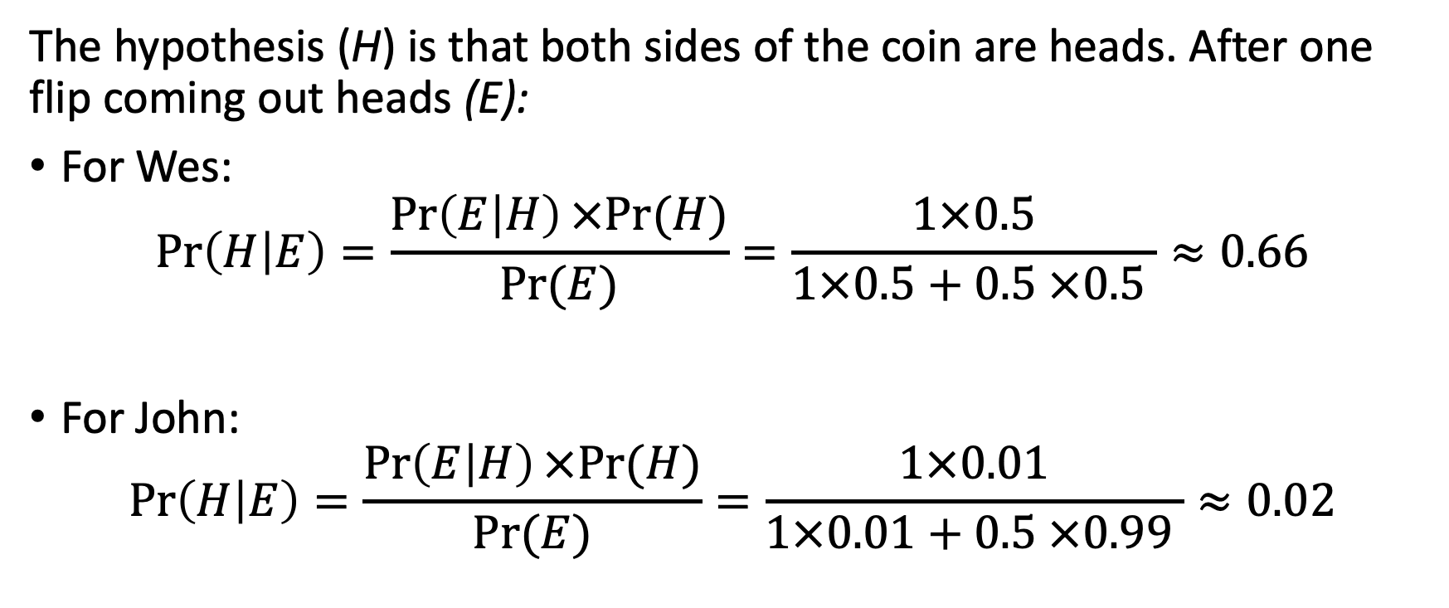
Example
The hypothesis (H) is that both sides of the coin are heads. After one flip coming out heads (E):
For Wes:
$$\operatorname{Pr}\left(H | E\right)=\frac{\operatorname{Pr}\left(E | H\right)×Pr⁡(H)}{Pr⁡(E)}=\frac{1×0.5}{1×0.5+0.5 ×0.5 }≈0.66$$
For John:
$$\operatorname{Pr}\left(H | E\right)=\frac{\operatorname{Pr}\left(E | H\right)×Pr⁡(H)}{Pr⁡(E)}=\frac{1×0.01}{1×0.01+0.5 ×0.99 }≈0.02$$

Slide 25
Example
Wes and John are trying to determine whether or not a coin has two heads. They cannot see the coin and only know the outcome after it is flipped.
Wes believes with 50% confidence that it has two heads. John thinks it is unlikely and assigns a probability of only 1% to that.
The first flip is heads. What is his updated probability?
Suppose the next flips all continue coming out of heads. How is the updated probability changing?

Slide 26
Example
Posterior
probability
1
Wes
0.5
John
0
5
10
15
20
No. of trials

Slide 27
Example
Wes and John are trying to determine whether or not a coin has two heads. They cannot see the coin and only know the outcome after it is flipped.
Wes believes with 50% confidence that it has two heads. John thinks it is unlikely and assigns a probability of only 1% to that.
The first flip is heads. What is his updated probability?
Suppose the next flips all continue coming out of heads. How is the updated probability changing?
Suppose one of the flips comes out tails. What is his updated probability?

